Slide 1
PASTIMES
sport books music magazines toys games
cinema
and other
through the years

Slide 2
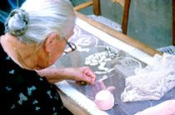
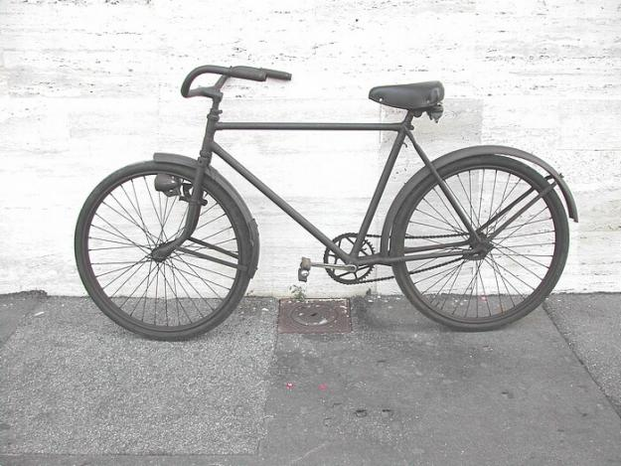
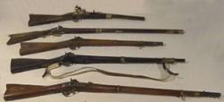
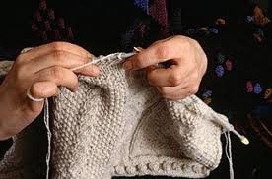
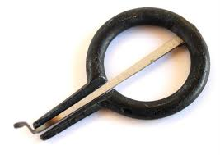
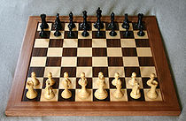
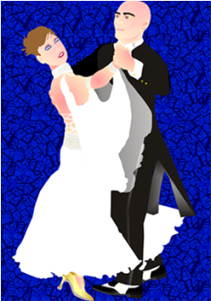
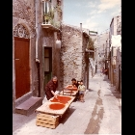
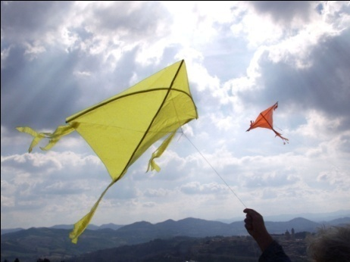
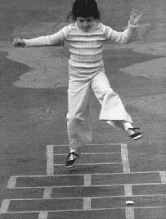

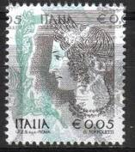
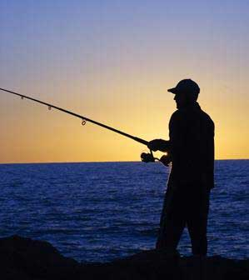
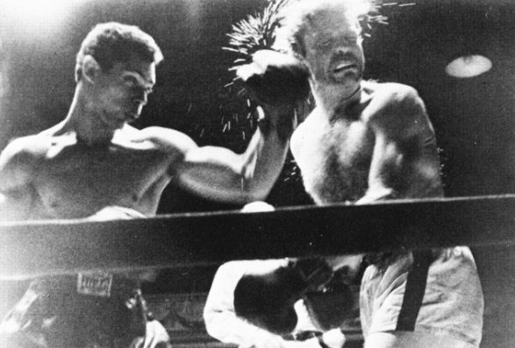
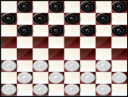
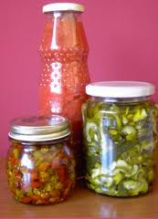
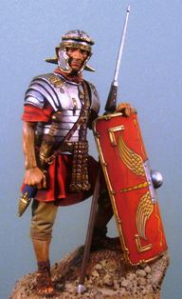
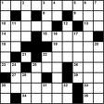

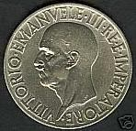
Traditional pastimes
embroidery - hunting - fishing - cards - knitting - sport - collecting
making conserves - flying kites - do-it-yourself - playing chess
gardening - plant growing - street games – crossword - dancing
sport watching….

Slide 3
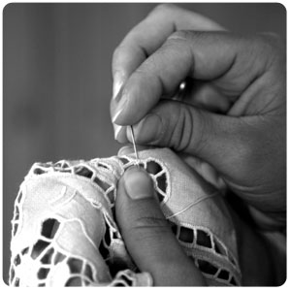
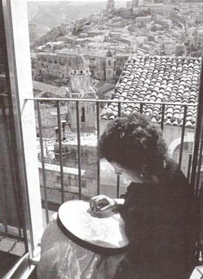
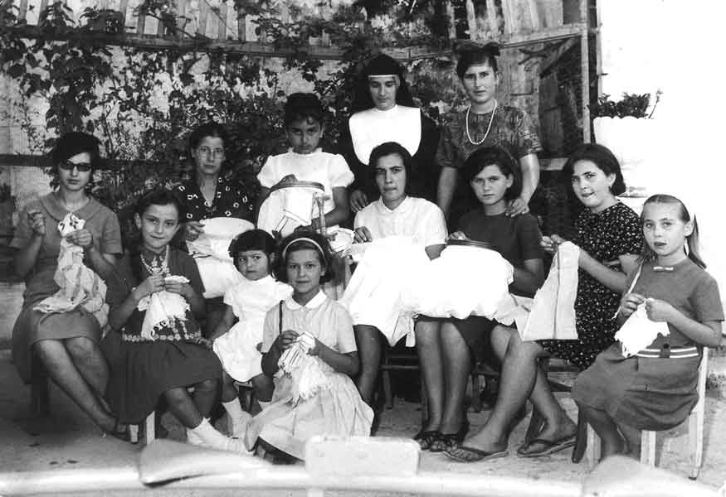
Unfortunatly Sicily art of lacemaking is dying.
Up to 20 years ago handmade local lace was very common in the houses. Now it is often made in China!
Lacemaking was one of the most traditional pastimes
Many women of all ages, and even little girls,
were fond of embroidery.

Slide 4
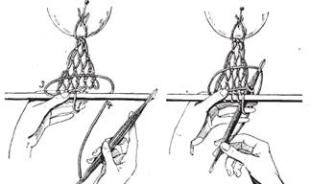
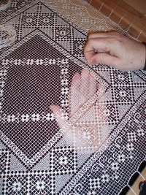
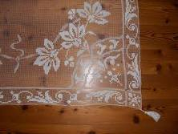
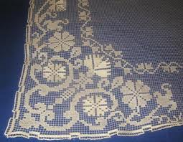
LACEMAKING “THE FILET”
Filet is one of the most ancient Sicilian lacemaking crafts.
Filet is the French word for “net”.
The ground consists of a delicate network made by hand with a particular needle called “modano".
On this ground the pattern is
worked usually by darning, the “point
of the toile” and “the point of reprise”
are the stitches most generally
employed

Slide 5
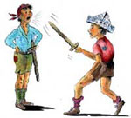
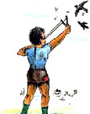
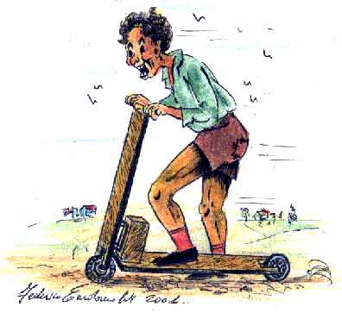
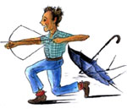
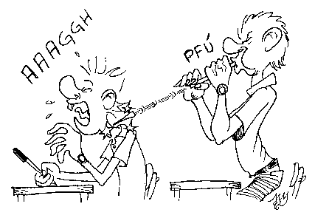
Old toys
Our grandparents and great grandparents enjoyed making their own toys with any useful material they found, such as pieces of metal, wood or strings.
Some of them could be
very dangerous,
like slings or gunslots

Slide 6
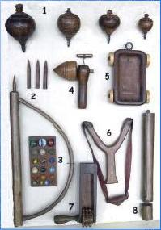
Toys for boys
1.Spinning toys – they were made spin just by pulling strongly a string wrapped around them
2. Arc gun – the barrel was cocked by arching the arc; the “bullet” was charged into it and the device was activated…paying attention to eyes!
3. Glass marbles
4. Spinning toy – with the draught on the pivot
5. Cart/buggy
6. Sling – a kind o weapon.
7. Treefrog rattle – it produced a noise similar to the crooking of frogs
8.Gunslot – it looked like a bicycle pump, it made little shots by pressing it

Slide 7
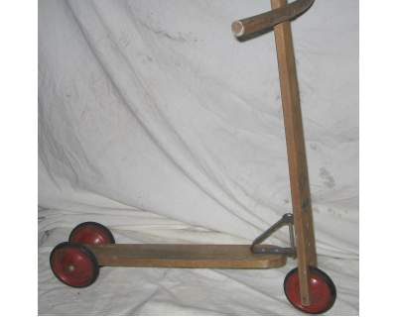
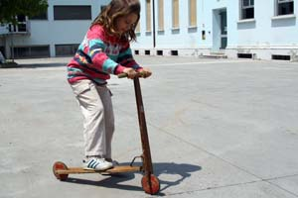
The scooter
The scooter was made of wood and iron, had two wooden wheels, a wooden stick and a handle fixed with a screw and a bolt. The child rested one foot on the wooden board, attached to the stick with an iron clamp.
A little girl trying an old scooter.

Slide 8
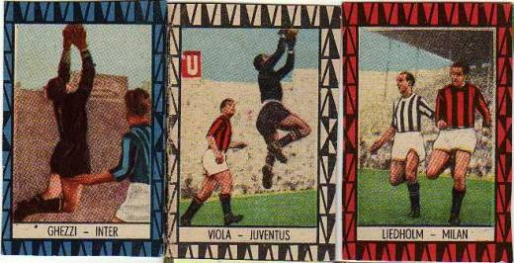
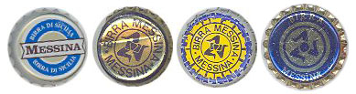
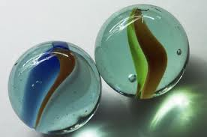
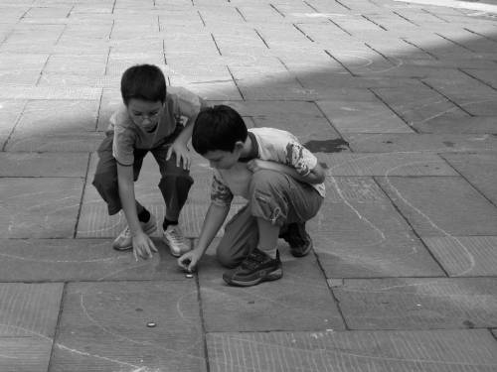
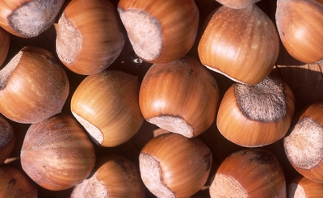
Boys also played with
bottle caps
marbles
football stickers
nuts
Two boys playing with bottle caps

Slide 9
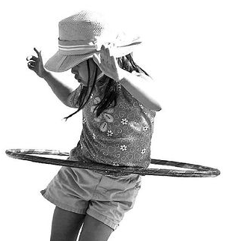
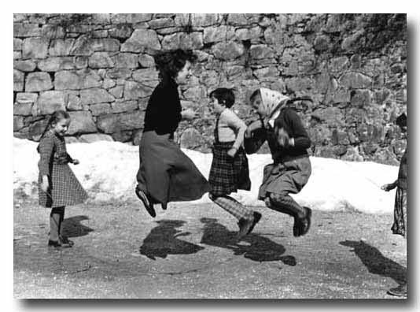
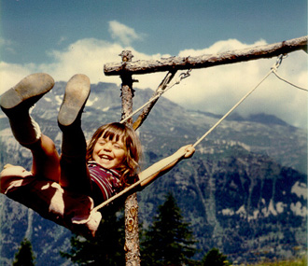
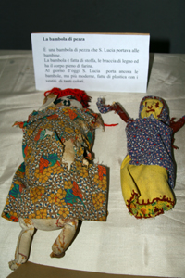
Girls usually played with
jump rope
hula hop
swing seesaw
rag dolls

Slide 10
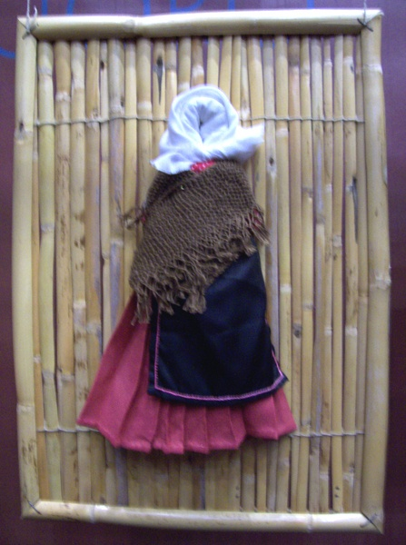
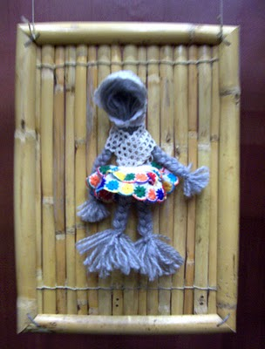
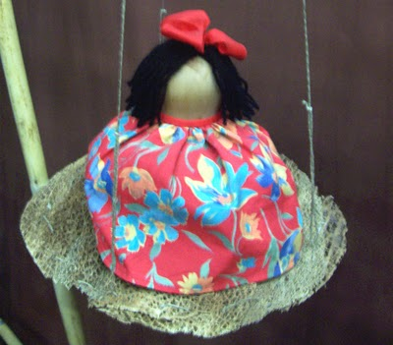
Old handmade rag dolls
They were made of cloth, wool and wood

Slide 11
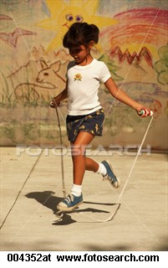
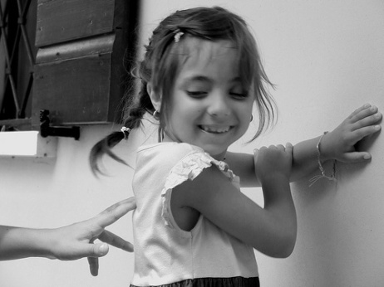
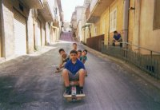
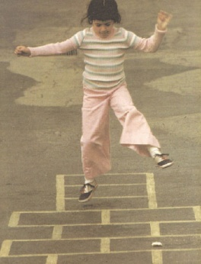
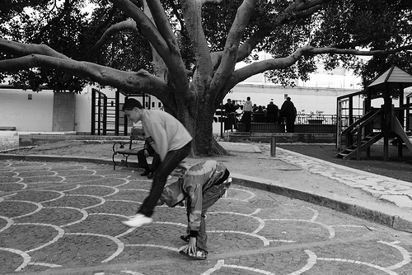






Street Games is a throwback to a time before pixels and processors when having fun meant making friends and sweating a little
Street games
Salto con
corda
Un due tre stella
la campana
o“al piede”
cursa chi carruzzuna
Travu longu
biglie
strummula
carta-forbici-pietra

Slide 12


.
AMMUCCIAREDDU
(hide-and-seek)
One seeker counts with closed eyes while the other children hide.
Then he/she opens his/her eyes and rushes to find the hiders. The last hider he/she finds is the winner of the round.

Slide 13

MOSCA CIECA
(blindman’s buff)
Age: 5 years on
Numbers of players: undefined
Where to play: anywhere
Items required: a handkerchief
One of the players is supposed to be blindfold with an handkerchief and to twirl, after being chosen by a counting rhyme.
He/she has to catch the other players while they are running everywhere around. He/she is asked to recognize the ones he/she catches. The first he/she recognizes will be the new “blindman’s buff”

Slide 14



The game of “tamburello”
It is a sort of ping-pong game using tamburines
instead of rackets.
The tamburello racket was made of wood and leather. The balls were made of jute (jute sacks) and were stitched with wool.
The players were usually two: they would hit the ball here and there trying not to let it fall
“Tamburelli” in a toy museum
Today playing “tamburello” is a pleasant sport on the beach called “tambeach”

Slide 15


The sack race
In the past,many games were played open air, one of these was the sack race in which two teams would play. Whoever was first across the line,won.
Old jute sacks were used
Some girls enjoying
a sack race today

Slide 16



Skittles
Skittles were used in good weather
outside in the courtyard, the game worked a bit like bowling. The skittles, brightly painted, were
made of wood.
Players take turns to throw wooden balls down a lane at the end of which are several skittles, trying to knock them over.
A modern skittle game in digital form

Slide 17
















The 50s and the 60s

Slide 18
In the 50s young people obeyed to their
parents, they usually had no conflicts with them.
In their free time many of them attended the parishes and played in the courtyards of the oratories, which were social centres and meeting places.
Their values and objectives were:
study, work and family.

Slide 19

A group of boys who played football in an oratory courtyard

Slide 20

Girls on a trip with nuns

Slide 21



Boy Scouts
On Sundays boy scouts
usually had excursions
out of town

Slide 22



Family parties were very common

Slide 23






Before the economic “Boom” handmade toys were still very popular
slingshot
Wooden scooter
bow
Yo Yo
“carruzzuni” (wooden skateboard)
skittles

Slide 24




Toys were a luxury or they were given on special occasions.
In Sicily it was (and still it is) a tradition to give toys to children on 2° November

Slide 25



Common free time activities were playing cards, pool or bowling

Slide 26

Sicilian traditional cards
The most popular games are “scopa” and “briscola”

Slide 27


Bars were usually frequented by men
They also met in specific clubs,
different according to their interests
Men outside a bar
Men in conversation outside a political club

Slide 28

In 1954 the television appeared
It was very expensive. People who
coud not afford it watched TV at their
neighbours’ or relatives’ .
At first programmes were broadcast
only for four hours.
In 1957 advertising was introduced
with “Carosello”, it lasted ten minutes.
A particular programme was devoted to children, called the “TV dei ragazzi”, it consisted mostly of cartoons and films. Popular films were “Lassie” and “Rin tin tin” “Zorro, among the cartoons some of the most loved were Popey, Gatto Silvestro, Tom and Jerry. .

Slide 29







Children liked watching…

Slide 30


People often took pictures near or around the television. Television had replaced “the fire”.

Slide 31








Children collected stickers of their favourite films or cartoons in albums

Slide 32






From 1960 sticker albums edited by “Panini” became very popular, mostly football player stickers

Slide 33





A symbol of the 50s and the 60s was the mythical “Vespa” by Piaggio
Today it is
a “Vintage”
scooter

Slide 34

After the economic “Boom” of the 60s more and more people went on holiday.
The most loved car was the Fiat 500

Slide 35

In the early 60s in many bars juke boxes and flippers appeared, imported from the USA. The juke box contained the best of Italian and foreign music. More and more young listened to music.
The juke box
How many friends and
love stories around a
juke box!

Slide 36


The flipper
It originates from the old game of the “bagatelle”. The players shoot balls towards the semi-circular end of the board with the objective of getting the balls to land in scoaring holes and areas on the board surface
In modern-day pinball machines the
traditional scoring mechanism is replaced by an electronic device, whereby the balls score points as they travel around the game surface, rather than scoring when they come to a halt
1931
1950

Slide 37


It was in the mid 70s that fully electronic pinball machines were first introduced, starting a huge wave of public popularity due to the new games innovations and features like electronic scoring, sound and speech.It lasted well till the late 80’s.
Video digital pinball machines replicate the look, play and feel of a traditional pinball machine
Today

Slide 38


In the 60s many young boys wore jeans and
t-shirt, they loved Rock ‘n’roll and motorcycles. Their idols were Marlon Brando in “the wild one” and James Dean in”Rebel without a cause”

Slide 39

45 rpm vinyl records were very popular between 1964 and 1970.
The Rock ‘n’roll fever spread
through the world and also in Italy.
In the 60s Rock music became the “rebel” music, was the artistic expression of the generational revolt. Elvis Presley first, then The Beatles, The Doors, Janis Joplin,Jimi Hendrix etc…, became the idols of the new generations. In 1962 the ministrel Bob Dylan sang
“The time they are A-changin’ “

Slide 40




Young people listened to and danced Rock ‘n Roll.
The Italian king
of the Rock was
Adriano Celentano.
Other popular Italian bands with the youngs:

Slide 41





Cult movies between the 50s and the 60s

Slide 42





















The 70s

Slide 43


Travelling
Young people started to travel all over Europe by car, the most popular was Fiat “500”. Some of them travelled hitchhiking

Slide 44

Rock music was widely listened to and the ones who could sing and play started bands imitating their idols.
They often played at parties

Slide 45

Many young spent their free time in game rooms playing flipper (pinball), pool and table football.
.

Slide 46


Table football is often played for fun in Pubs, bars, workplaces, schools and
clubs, with few rules.
Organized competitions can be traced back to the 1940’s and 1950’s in Europe.
But the professional tours and big money events began in 1976
Table tennis competitions were also popular among the young.
They often organized tournements
for fun.

Slide 47




)
How to make a
“Scoubidou”
In the 70s it was very common to make scoubidous. They were often used as keyrings
HOW TO START
Take 2 (or 4) strings, of different colours and tie them together .
Separate the four strings accuratly
1
2
3
Take one of the strings and pass it on the other side doing an arch. Do the same with the string of the opposite site. Pass the other wires through the arch (one by one) and pull them hard. Repeat until the strings come to their end. Finally burn the end of the strings with a lighter, so that they are welded.
Anyway you will learn quickly if someone shows you.

Slide 48












Comics were very popular, teenagers and even adults spent much of their free time reading them. They were relaxing, amusing and a fascinating medium of literature. The most widely read were:

Slide 49








Cult movies in the 70s

Slide 50
Going to the cinema
Going to the cinema has always been a popular pastime since the 50s.
From the 70s to the first half of the 90s
more and more teenagers used to go to the cinema, usually at weekends.
Nowadays they are fewer, many of them prefer unloading them from the Internet or to hire them
The Sicilian director Giuseppe Tornatore in “Nuovo cinema Paradiso”
shows how popular the cinema became
after World War II.

Slide 51

















The 80s

Slide 52
Leasure gets a big market
In the 80s marketers target kids and young people in general: they have their own purchasing power, they influence their parents’buying decisions and they are the adult consumers of the future.
Parents are willingly to buy more for their
children: trends such as smaller family size, dual incomes mean that family have more disposable income. Children’s free time is often organized by their parents who encourage them to take part in extra activities:
dancing, sport, music, foreign language…

Slide 53

















Young people become heavy consumers of
Toys
comics
records
videogames
board games
sport equipment

Slide 54





Children grow watching cartoons on tv and eating snacks
Portable videogames: a popular pastime

Slide 55

The Rubik’s cube
a successful pastime of the 80s
The Rubik’s cube is a 3-D mechanical puzzle invented in 1974 by the Hungarian sculptor and professor of architecture Emo Rubik.
In a classic Rubik’s cube, each of the six faces is covered by nine stickers, among six solid colours (traditionally white, red, blue, orange, green and yellow). A pivot enables each face to turn indipendently, thus mixing up the colours.
For the puzzle to be solved, each face must be a solid colour.

Slide 56








Cult movies in the 80s

Slide 57
















What’s new in the 90s

Slide 58


karaoke
It became popular in Italy thanks to the popular DJ Fiorello, who presented a karaoke show on TV, each time from a different town square.
From then on karaoke nights and parties were organized both at home and in public places. In the 90s it was one of the most favourite pastimes

Slide 59



The “Play Station Generation” was born
Boys’ favourite games are fight games,
the most popular is “tekken”.

Slide 60




.
New card games
Magic: The Gathering appeared
in 1993:it consists of a card-based-role-playing game where the players act as wizards. The players take turns using their customized desks of cards to damage and defeat their opponent.
The Pokémon Trading Card Game is a collectible card game based on the Pokèmon video game series. The game is centered on the concept of the Pokémon battle. All Pokémons have attaks and hits points.

Slide 61








Cult movies in the 90s

Slide 62

The 2000s
GLOBALIZATION
HIGH TECHNOLOGY
INFORMATION TECHNOLOGY

Slide 63









The top ten key words
to identify Italian young people’s interests
Social network
Loading/unloading
Chatting

Slide 64













Blog
The “i”
The “e”
SMS
email ebook efriend emarket

Slide 65







Web Surfing
Video games

Slide 66





Fantasy

Slide 67
They also spend their time
walking
keeping fit
meeting friends
doing voluntary work
and anything they like

Slide 68

IV N

Slide 69
With the collaboration of IV O
as regarding the section “old toys”

