Slide 1
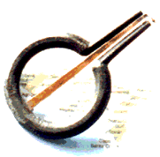
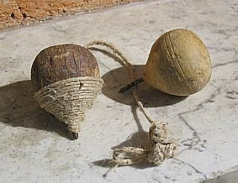

Two old pastimes
“U marranzanu”
“A strummula”

Slide 2
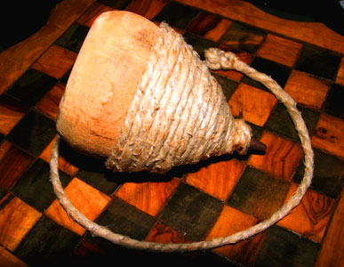
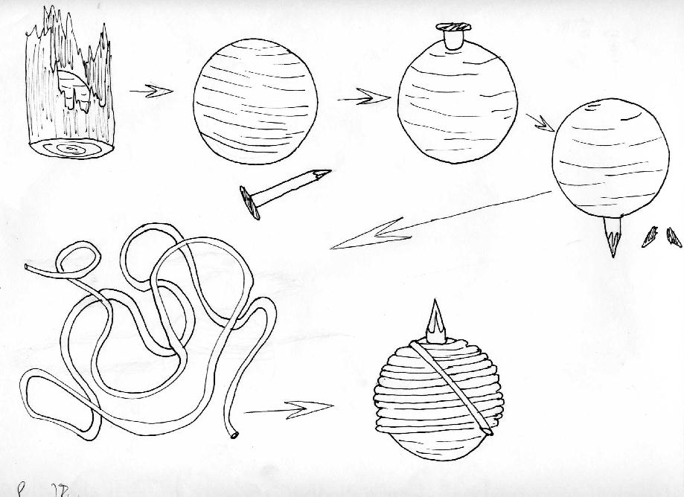
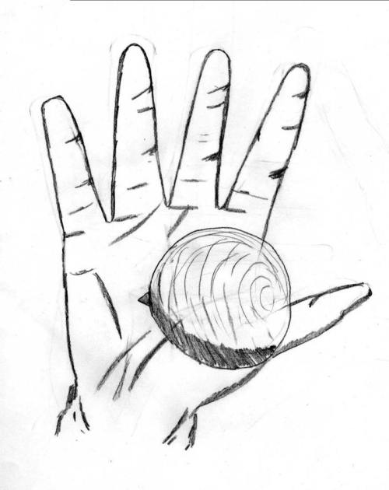
“A strummula”
The most famous Sicilian toy was the “strummula” . The children played with it in autumn.
The game started with the preparation of the arena called “pi strata” it was in streets where there was no traffic and it was 10 m².
The players decided who played and who had to be a sort of referee who checked for the players to respect the rules of the game, this was the “appuzzatu”.

Slide 3
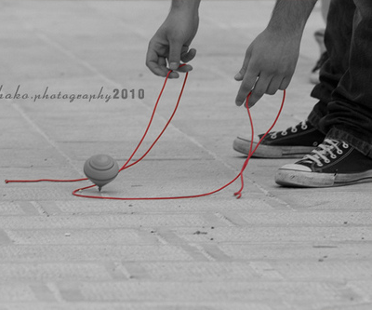
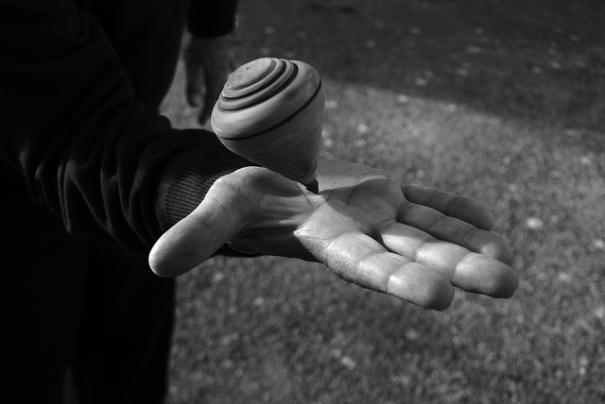
The “appuzzatu” put his spinning top in a hole. The first player had to hit the spinning top in the hole.
The player won when his spinning top stopped near the “appuzzata”, then the other players did the same.
When all players had done that for ten turns the game ended. The player who had played worst then exchanged his place with the “appuzzatu”.

Slide 4
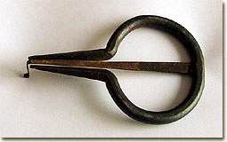
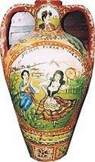
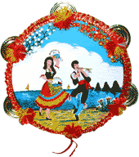
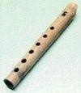
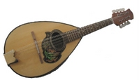
“U marranzanu”
One of the traditional pastime activities in Sicily is playing folkloristic music. Traditional Sicilian instruments are “u fiscalettu" (it's a sort of flute),
“ u marranzanu” (in English "Jew's Arp"), "u bummulu" (a sort of jar, used for storing food or as musical instrument), “u mannulinu” (a sort of little guitar or ukulele, in English it is "mandolin") and the "tammureddu“ (in English "tambourine").
"u bummulu"
“u fiscalettu"
“u mannulinu”
"tammureddu”

Slide 5
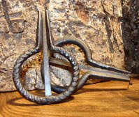
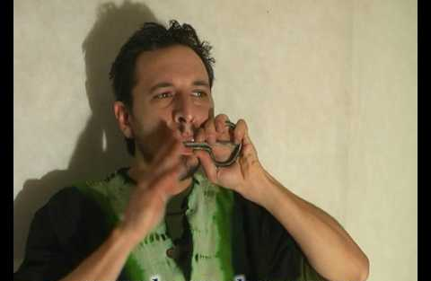
“U marranzanu’ is a horseshoe-shaped
idiophone instrument with a metal stripe
in the middle, then it plays thanks to
the player's skill, not thanks to the
instrument itself.
The sound it produces is "boing boing“.
For playing it, the musician must bite the instrument at its "end" (the straight part of the instrument) and move the tongue (to modulate the sound) and the flexible metal stripe (to make the sound, of course).
The player's mouth is the part which "sounds", not the instrument itself...This means that if the player makes a mistake he can injure his mouth or his teeth.
Actually there are three ways of playing the "marranzanu":
By moving the stripe and the tongue
By moving the stripe and breathing
And by moving the stripe and increasing the volume of the mouth.
These three "styles" of playing produce different sounds.

Slide 6
CLASSE IV G

