Slide 1

Liceo Scientifico
“Benedetto Croce” via Benfratelli,4
Palermo
Website www.benedettocroce.eu

Slide 2
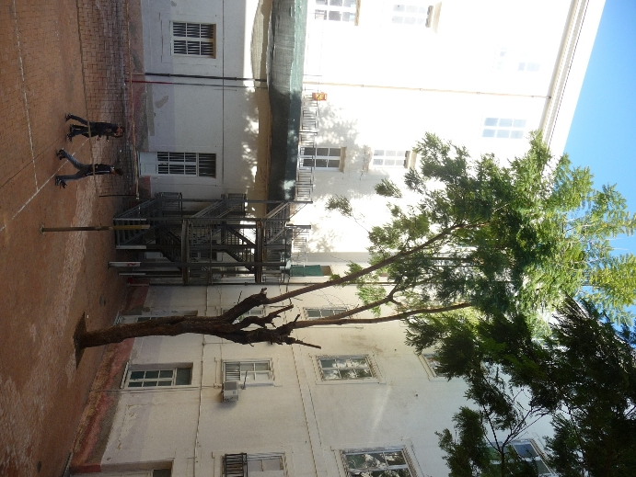
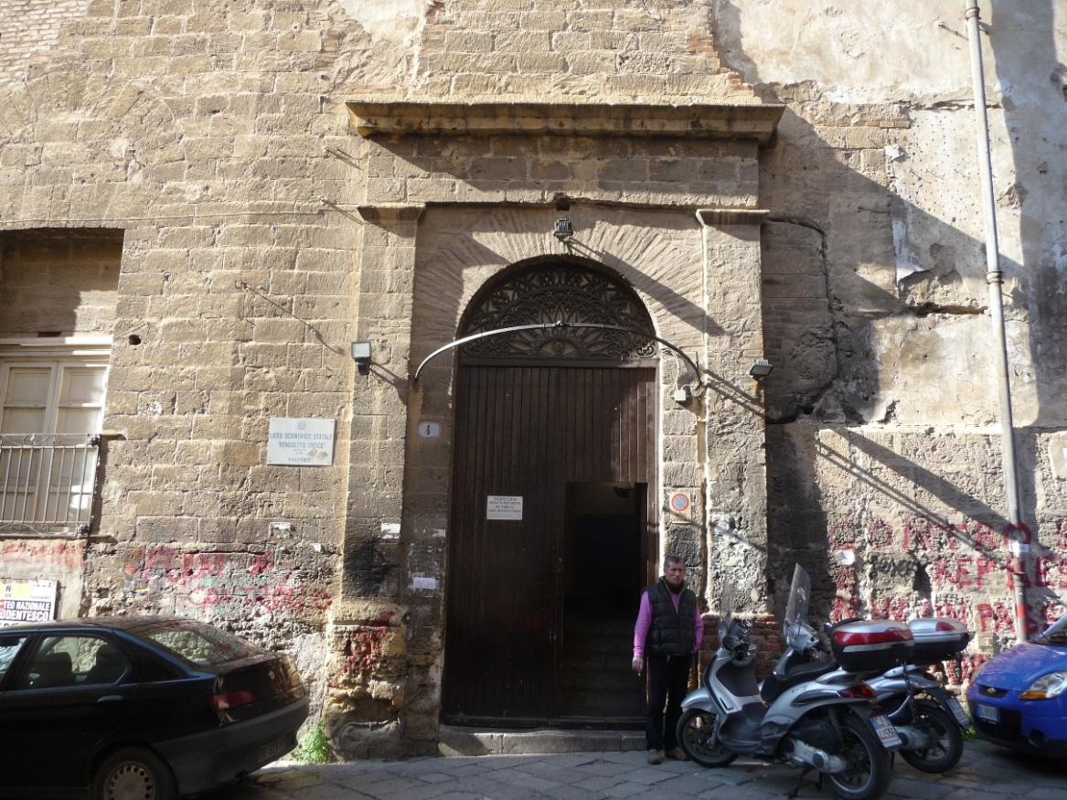
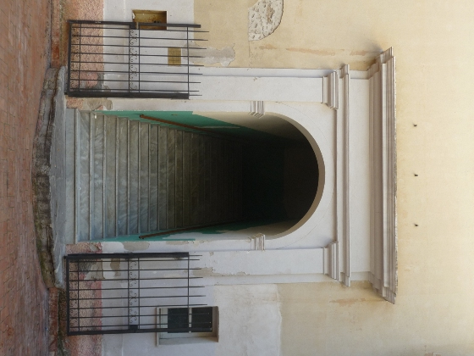
The headquarters of the liceo scientifico “Benedetto Croce”
is situated in the centre of the old city.

Slide 3
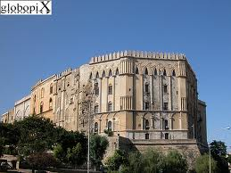
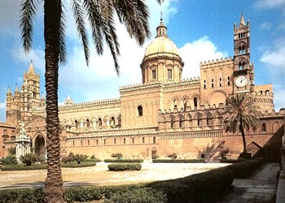
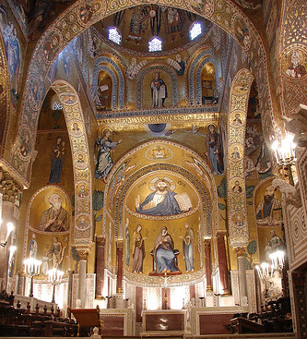
It is only a few steps away from the Cathedral, the Royal Palace and the Cappella Palatina, in the so called “Albergheria” district.

Slide 4
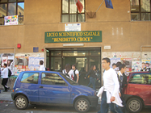
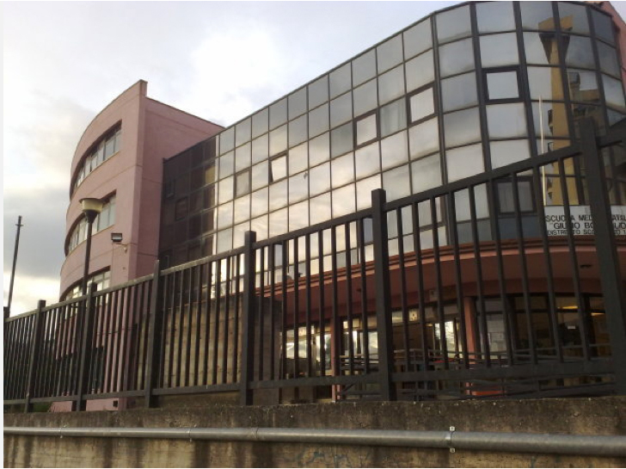
Today the Institute has two more bases:
one in via Filipppo Corazza,(near the central railway station),
the other in via Imera, not far from the Royal Palace.
The students are 1836, divided in 76 classes; 29 classrooms are in the
main base in via Benfratelli, 36 are in via F. Corazza and 13 in via Imera.
Some students come from neighbouring towns (Monreale, Altofonte, Belmonte Mezzagno, Misilmeri, Piana degli Albanesi, Villabate.)

Slide 5
The main building, where the headquarters is located, was built on the Punic-Roman city walls which originally surrounded ancient Panormus.
It was once a hospital, the first one built by the brotherhood “Fatebenefratelli”.
The building works, started in 1587, required the demolition of one of the two towers of the ancient Saracenic door “Busuemi”; the other tower , the so called “Torre di Scrigno”, still well-preserved, is inside Count Federico palace, adjoining our institute.
This tower is one of the few remaining parts of the old city wall.
Historical sights

Slide 6
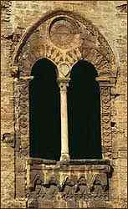
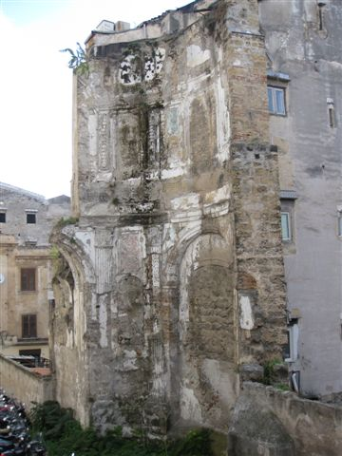
The “Torre di Scrigno”(XII sec.)
A few remains from the old hospital church

Slide 7
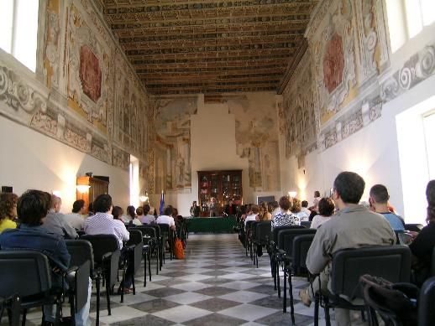
The building was already aimed at being a school in 1887, but
it was heavily damaged during the second world war and since
then it has undergone several reconstructions.
Since 1978 it has been the headquarters of the liceo “B. Croce”,
and the ancient “ward hall” is today its main hall.

Slide 8
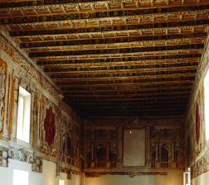
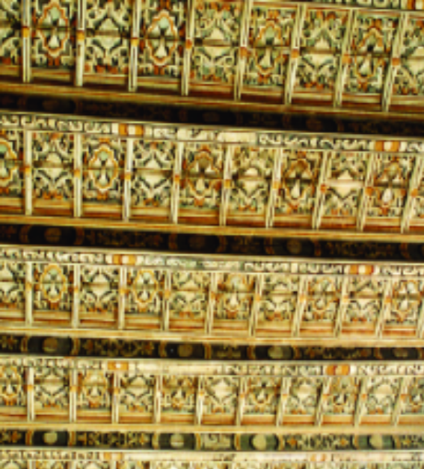
Today we can admire some valuable architectural remains of the ancient building, especially the main hall of the school with its walls almost entirely covered with frescoes
and its wooden paneled ceiling. The frescoes have been attributed to the famous painter Pietro Novelli(1603 1647)
Particular of the wooden ceiling

Slide 9
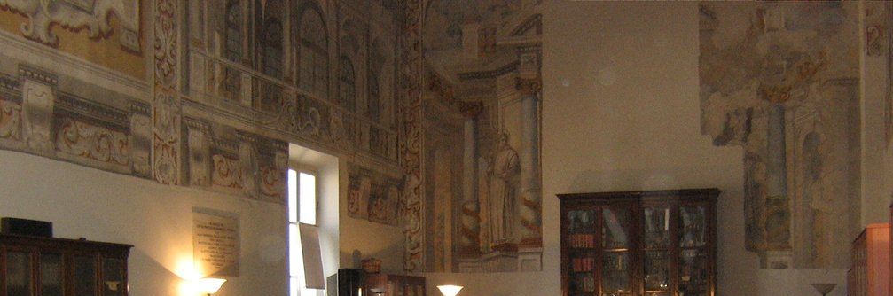
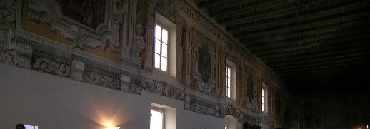
Sights of the frescoes

Slide 10
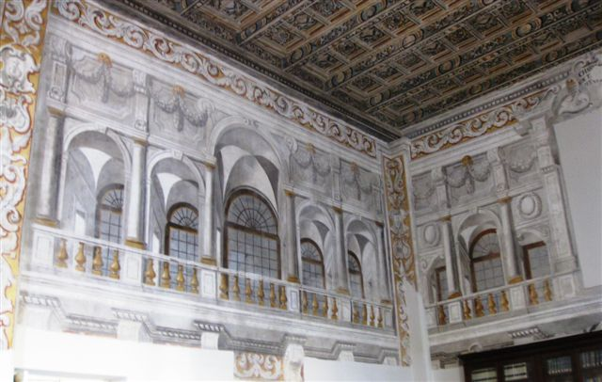
An impressive example of trompe d’oeil technique

Slide 11
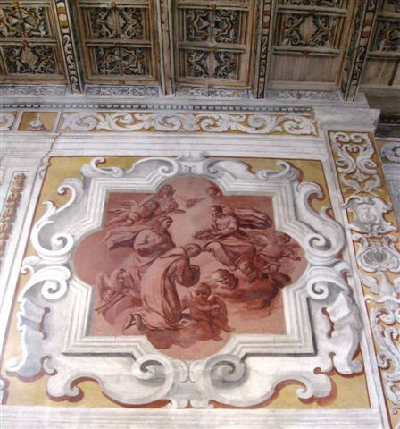
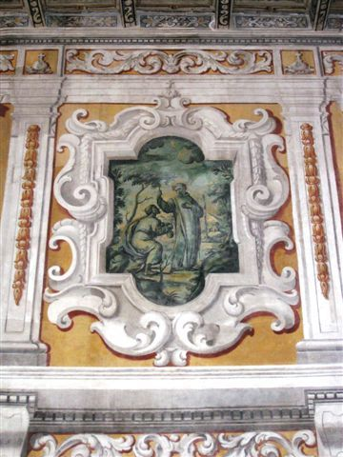
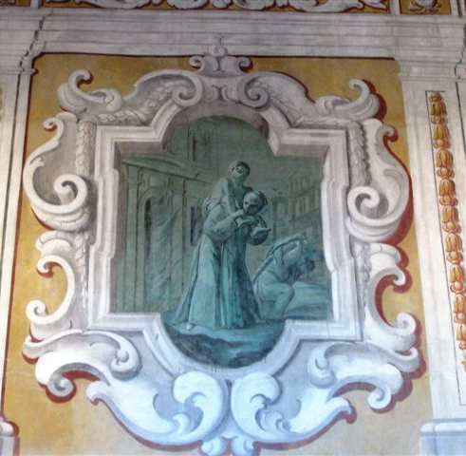
Some particulars of the frescoes attributed to the painter Pietro Novelli.
They represent the main episodes from the life of St John of God.

Slide 12
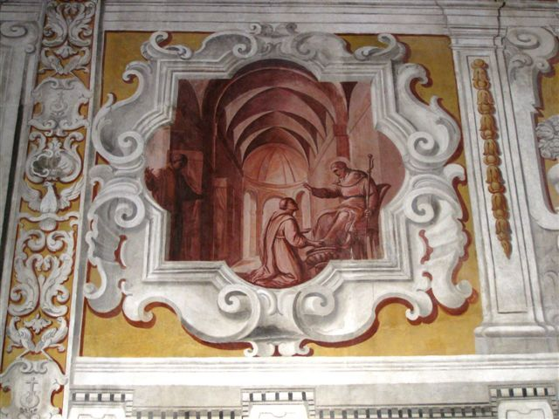
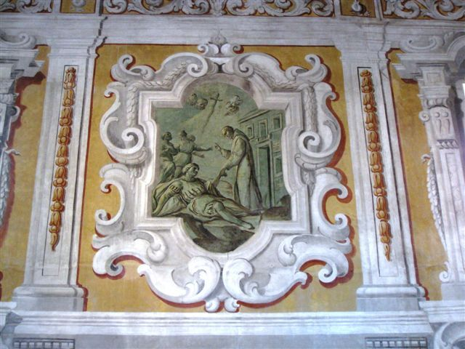
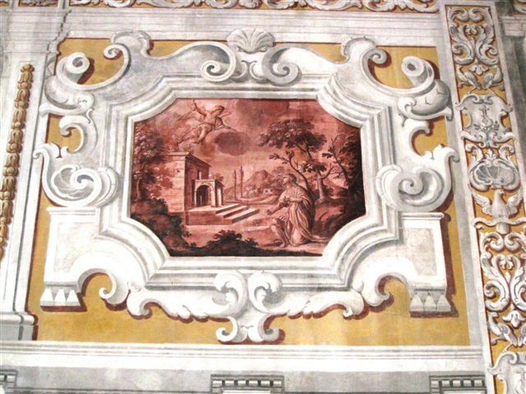
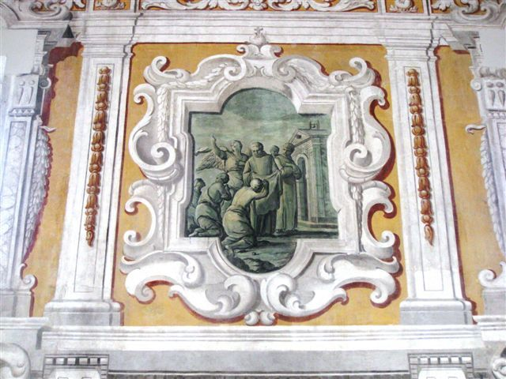

Slide 13
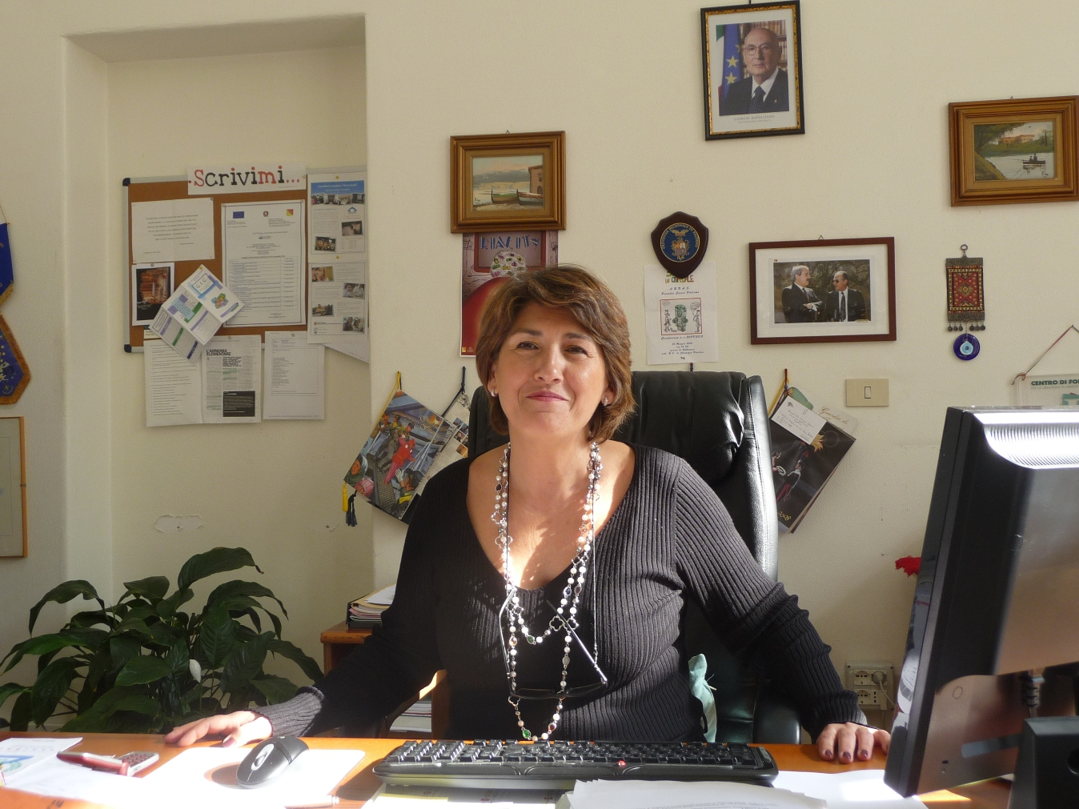
Mrs Anna Maria Catalano
(the headmistress)

