Slide 1
I hope one day we will become important people
Our dreams for future…

Slide 2
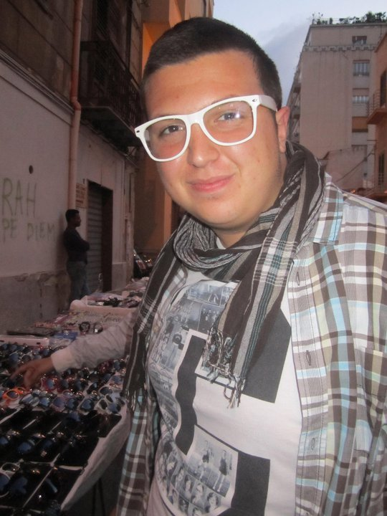
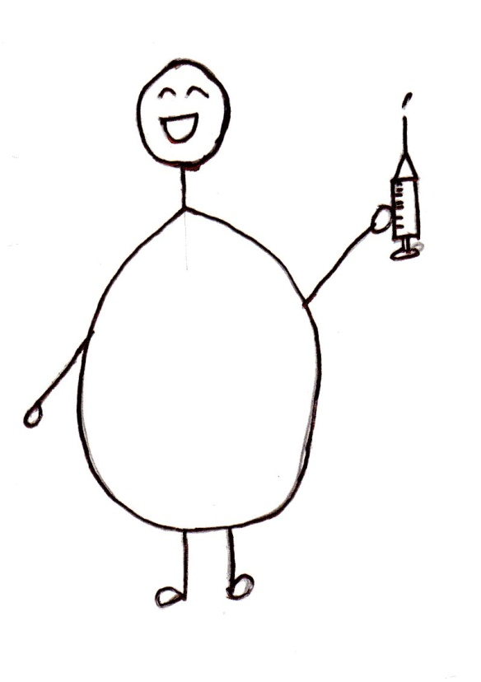
DOMENICO: nurse
He will help in saving lives.

Slide 3
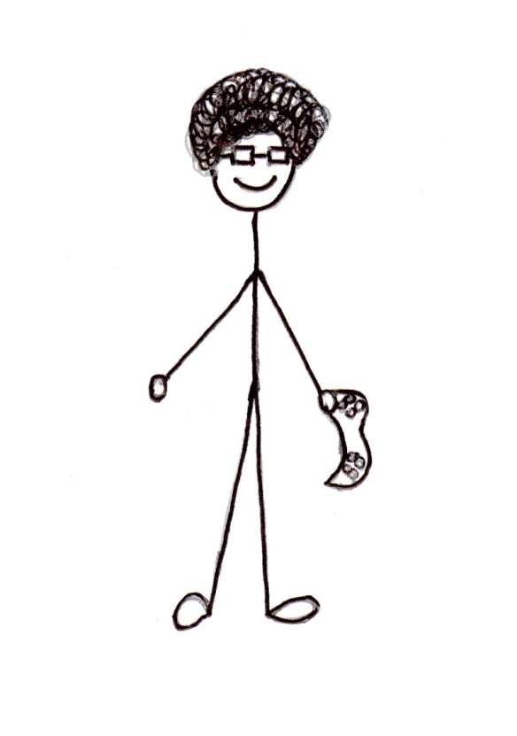
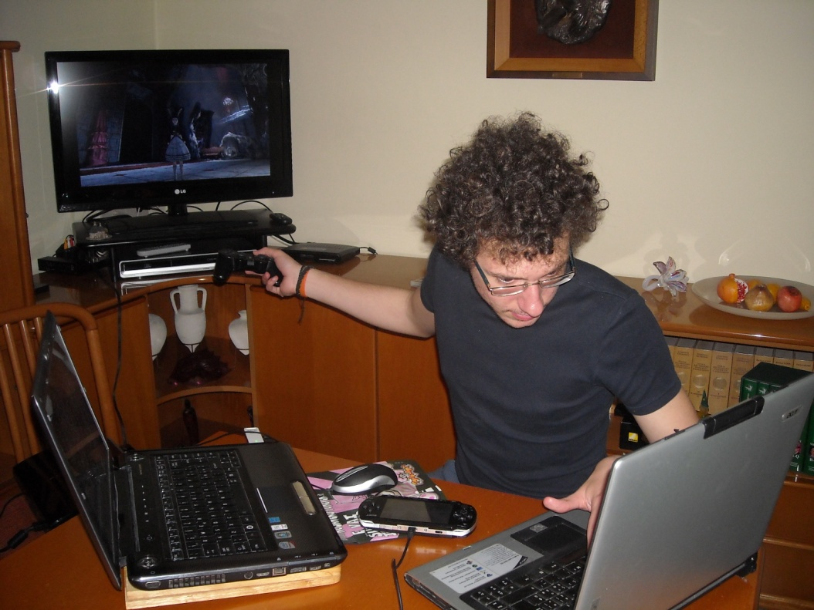
FRANCESCO: videogames programmer
He will improve and ruin at the same time young people’s life.

Slide 4
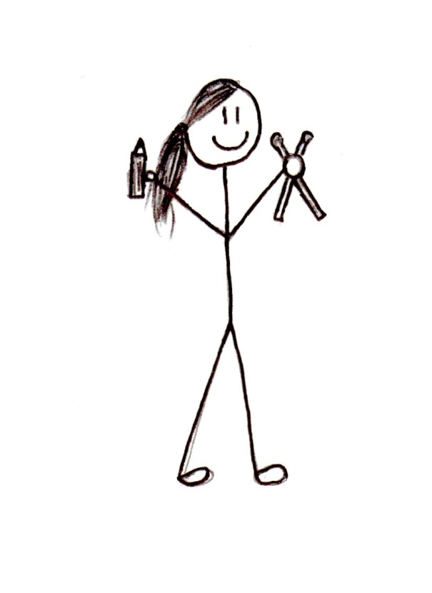
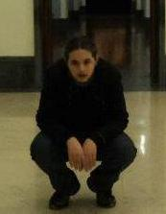
MAURIZIO: musician and cartoonist
Someone will read his comic books while they listen to his music.

Slide 5
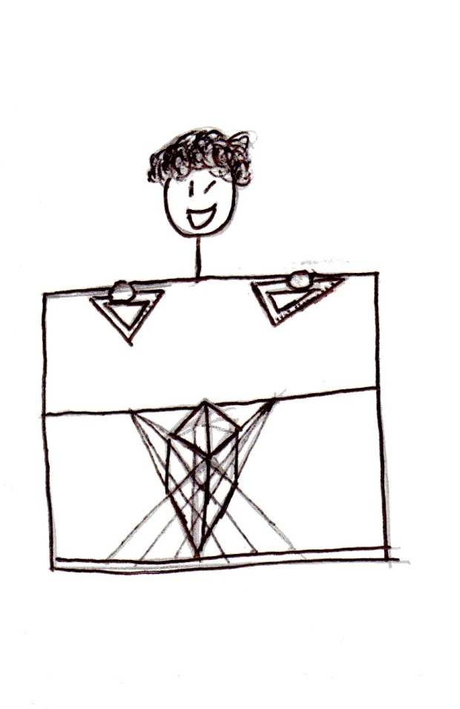
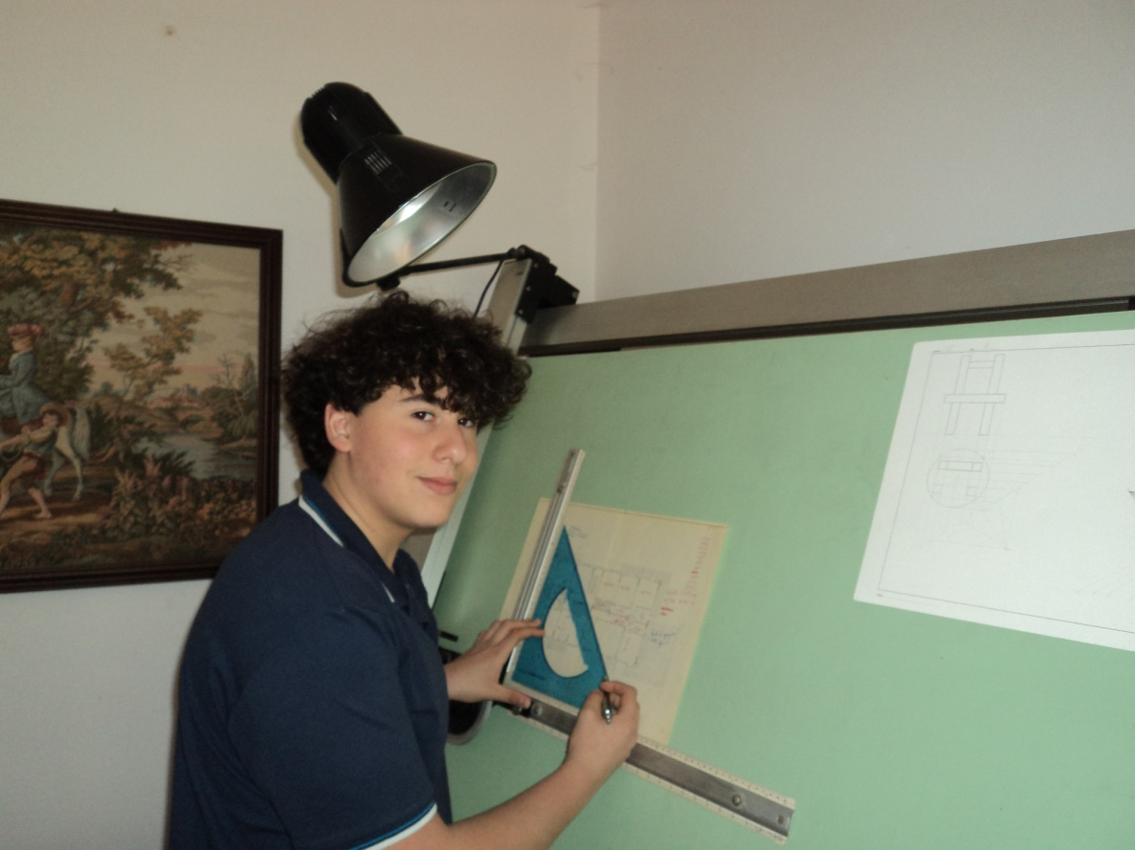
DANIELE: architect
We will find him in history of art books.

Slide 6
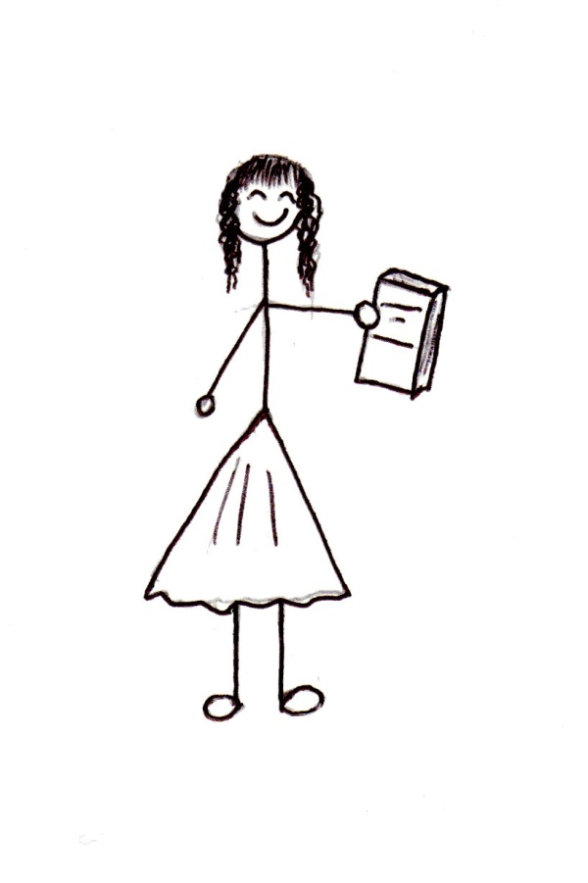
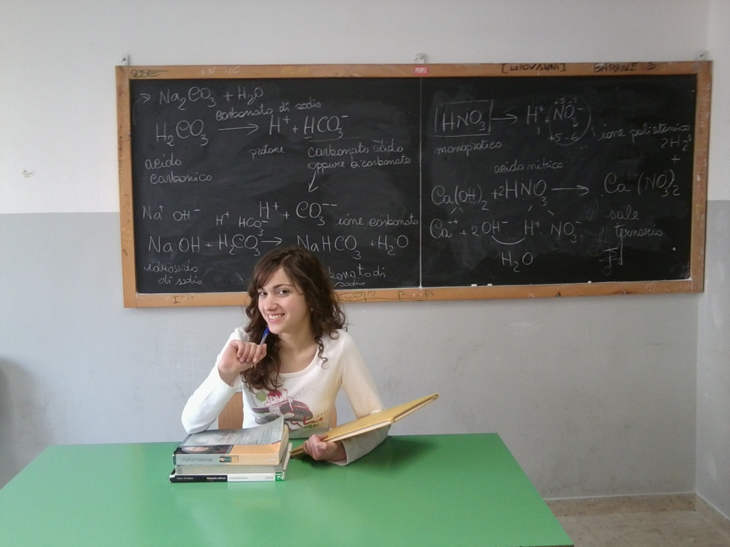
SIMONA: teacher and writer
I will make my students dream, and I will be their nightmare at the same time!

Slide 7
Surely you will say we are mad, but these are our hopes…
SO, LET US DREAM!!!

